Slide 1
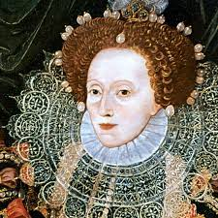
What You ARE Studying at GCSE?
History GCSE
Edexcel
Weimar and Nazi Germany
Cold War
Medicine Through Time
Elizabeth I
Geography GCSE
AQA
Physical: Hazards, Ecosystems & UK Landscapes
Human: Urban issues, Economic World & Resource Management
Skills: Fieldwork & Issue Evaluation.
RS GCSE
AQA
Buddhism
Christianity
Themes - The Family, Religion & Life, Crime & Punishment & Social Justice.

Slide 2
What You ARE Studying at a level?
History A Level
AQA
Unification of Germany
English Reformation
British Involvement in Northern Ireland (The Troubles) for NEA
Geography A Level
AQA
Physical: Water & Carbon Cycle Hazards, Coast, & Ecosystems
Human: Global Systems & Global Governance, Population, & Changing Places
Skills: Fieldwork & NEA.
RS A Level
AQA
Philosophy of Religion
Inc. Arguments for the existence of God, miracles, religious language, Evil & Suffering, Religious Experience, Self, Death & The Aftlerlife
Ethics & Religion
Psychology A Level
OCR
Research Methods
Psychological themes through core studies.
Applied Psychology – Mental Health, Criminal & Child Psychology.

Slide 3
Humanities Revision Techniques
There are so many ways to revise, and you will have your preferred techniques, but we would recommend the following for each chapter/subtopic:
Revision booklets (supplied by some subjects)
Content tests (GCSEPod-Check & Challenge/ Seneca)
Video clips (GCSE Pod/Youtube)
Past paper questions (planning and writing)
Additional Strategies:
Mind maps
Revision cards
Stats/key term grids
Timelines
Taboo/Key Terms Cards
Podcasts
views/Key debates
Textbook Key Qs

Slide 4
Humanities Revision Techniques

